Slide 1
Register

Slide 2
Flip Flip
Flip-flop is a 1 bit memory cell which can be used for storing the digital data. To increase the storage capacity in terms of number of bits, we have to use a group of flip-flop. Such a group of flip-flop is known as a Register. The n-bit register will consist of n number of flip-flop and it is capable of storing an n-bitword.
The binary data in a register can be moved within the register from one flip-flop to another. The registers that allow such data transfers are called as shift registers. There are four mode of operations of a shift register.
Serial Input Serial Output
Serial Input Parallel Output
Parallel Input Serial Output
Parallel Input Parallel Output

Slide 3
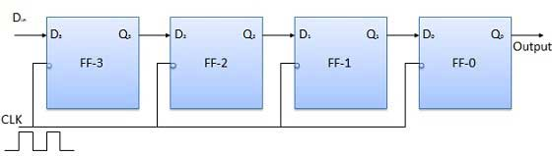
Serial Input Serial Output
Let all the flip-flop be initially in the reset condition i.e. Q₃ = Q₂ = Q₁ = Q₀ = 0. If an entry of a four bit binary number 1 1 1 1 is made into the register, this number should be applied to D_{in} bit with the LSB bit applied first. The D input of FF-3 i.e. D₃ is connected to serial data input D_{in}. Output of FF-3 i.e. Q₃ is connected to the input of the next flip-flop i.e. D₂ and so on.

Slide 4
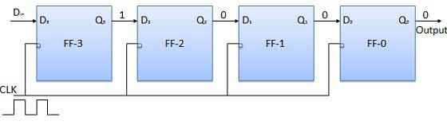
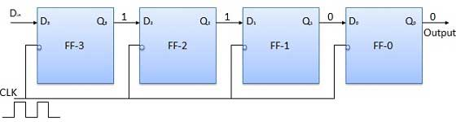
Operation
Before application of clock signal, let Q₃ Q₂ Q₁ Q₀ = 0000 and apply LSB bit of the number to be entered to D_{in}. So D_{in} = D₃ = 1. Apply the clock. On the first falling edge of clock, the FF-3 is set, and stored word in the register is Q₃ Q₂ Q₁Q₀ = 1000.
Apply the next bit to D_{in}. So D_{in} = 1. As soon as the next negative edge of the clock hits, FF-2 will set and the stored word change to Q₃ Q₂ Q₁ Q₀ = 1100.

Slide 5
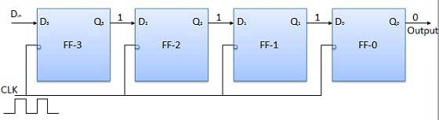
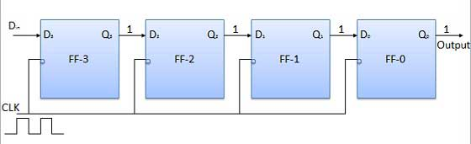
Apply the next bit to be stored i.e. 1 to D_{in}. Apply the clock pulse. As soon as the third negative clock edge hits, FF-1 will be set and output will be modified to Q₃ Q₂ Q₁ Q₀ = 1110.
Similarly with D_{in} = 1 and with the fourth negative clock edge arriving, the stored word in the register is Q₃ Q₂ Q₁ Q₀ = 1111.

Slide 6
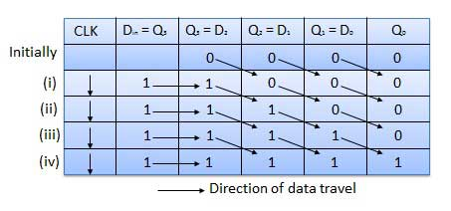
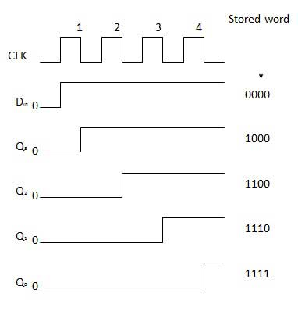
Truth Table
Waveforms

Slide 7
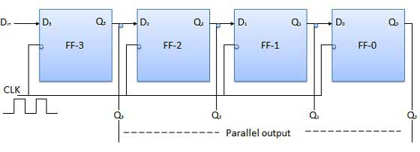
Serial Input Parallel Output
In such types of operations, the data is entered serially and taken out in parallel fashion.
Data is loaded bit by bit. The outputs are disabled as long as the data is loading.
As soon as the data loading gets completed, all the flip-flops contain their required data, the outputs are enabled so that all the loaded data is made available over all the output lines at the same time.

Slide 8
Parallel Input Serial Output (PISO)
Data bits are entered in parallel fashion.
The circuit shown below is a four bit parallel input serial output register.
Output of previous Flip Flop is connected to the input of the next one via a combinational circuit.
The binary input word B₀, B₁, B₂, B₃ is applied though the same combinational circuit.
There are two modes in which this circuit can work namely - shift mode or load mode.
Load mode
When the shift/load bar line is low (0), the AND gate 2, 4 and 6 become active they will pass B₁, B₂, B₃ bits to the corresponding flip-flops. On the low going edge of clock, the binary input B₀, B₁, B₂, B₃ will get loaded into the corresponding flip-flops. Thus parallel loading takes place.

Slide 9
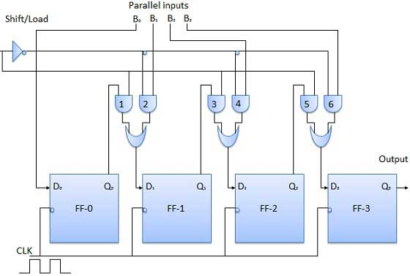
Shift mode
When the shift/load bar line is low (1), the AND gate 2, 4 and 6 become inactive. Hence the parallel loading of the data becomes impossible. But the AND gate 1,3 and 5 become active. Therefore the shifting of data from left to right bit by bit on application of clock pulses. Thus the parallel in serial out operation takes place.

Slide 10
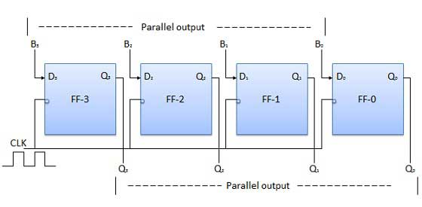
Parallel Input Parallel Output (PIPO)
In this mode, the 4 bit binary input B₀, B₁, B₂, B₃ is applied to the data inputs D₀, D₁, D₂, D₃ respectively of the four flip-flops. As soon as a negative clock edge is applied, the input binary bits will be loaded into the flip-flops simultaneously. The loaded bits will appear simultaneously to the output side. Only clock pulse is essential to load all the bits.

